Slide 1
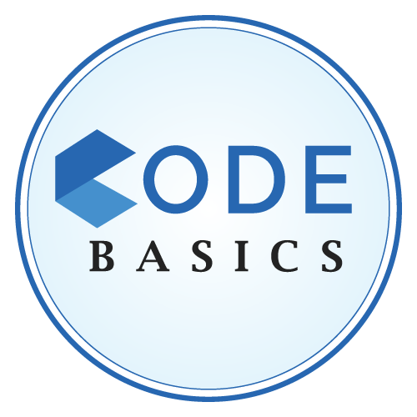


tliQ Hardware
CONSUMER GOODS
AD-HOC INSIGHTS
BY BALOGUN ALI
#codebasicsresumeprojectchallenge

Slide 2
tliQo Hardware
Table of Content
Introduction
Atliq’s Market
Ad-hoc analysis
BY BALOGUN ALI
#codebasicsresumeprojectchallenge

Slide 3
tliQo Hardware
Introduction
Atliq Hardwares (an imaginary company) is one of the leading computer hardware
manufacturers in India, with a strong presence in other countries as well.
However, management noticed that they are not getting enough insights to make quick and
informed data-driven decisions. They want to add several junior data analysts to their data
analytics team. Tony Sharma, their data analytics director, desired to hire someone with both
technical and soft skills. As a result, he decided to hold a SQL challenge to help him understand
both skills.
BY BALOGUN ALI
#codebasicsresumeprojectchallenge

Slide 4
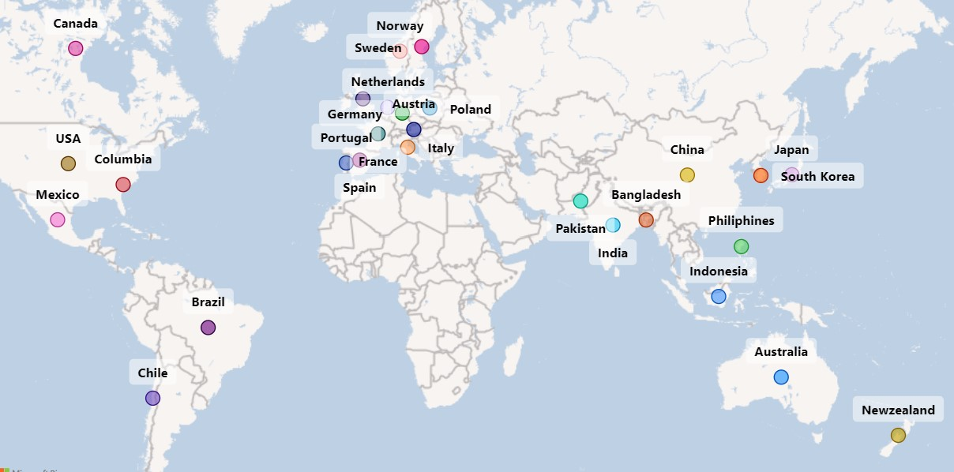
tliQo Hardware
Atliq’s Market
BY BALOGUN ALI
#codebasicsresumeprojectchallenge

Slide 5
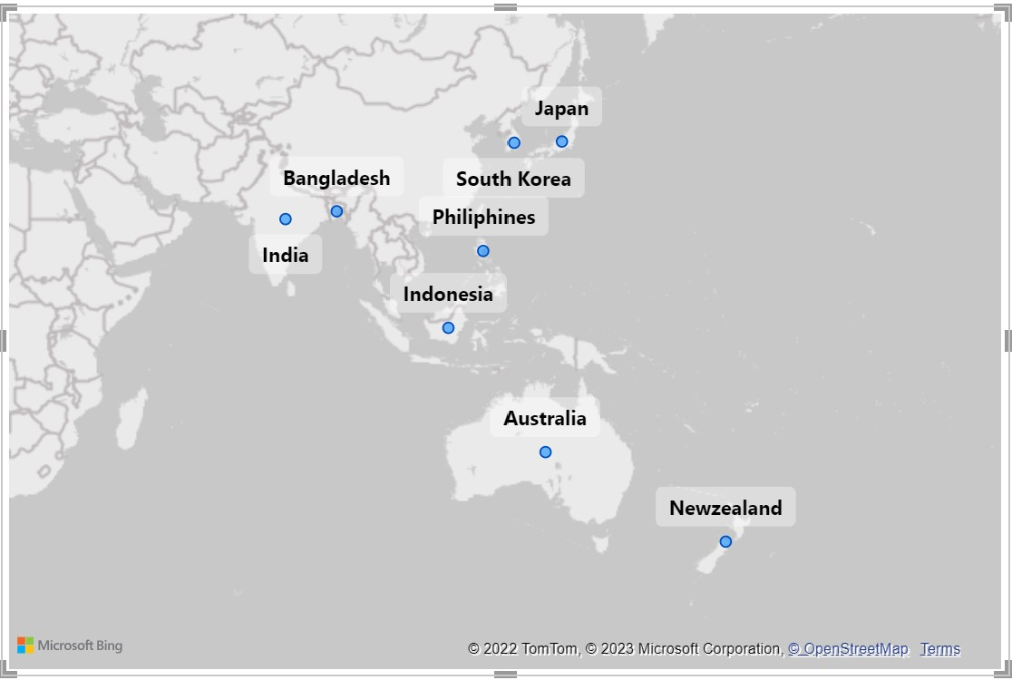
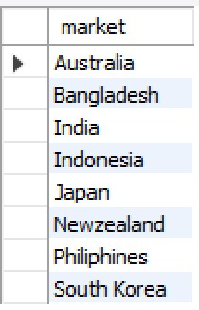
tliQo Hardware
Ad-hoc Analysis
Request 1
Visual
Provide the list of markets in which customer "Atliq
Exclusive" operates its business in the APAC region.
Output:
BY BALOGUN ALI
#codebasicsresumeprojectchallenge

Slide 6
tliQo Hardware
Insight
Out of the 27 Markets, Atliq Exclusive has established its presence in 8 major markets in the APAC region
BY BALOGUN ALI
#codebasicsresumeprojectchallenge

Slide 7
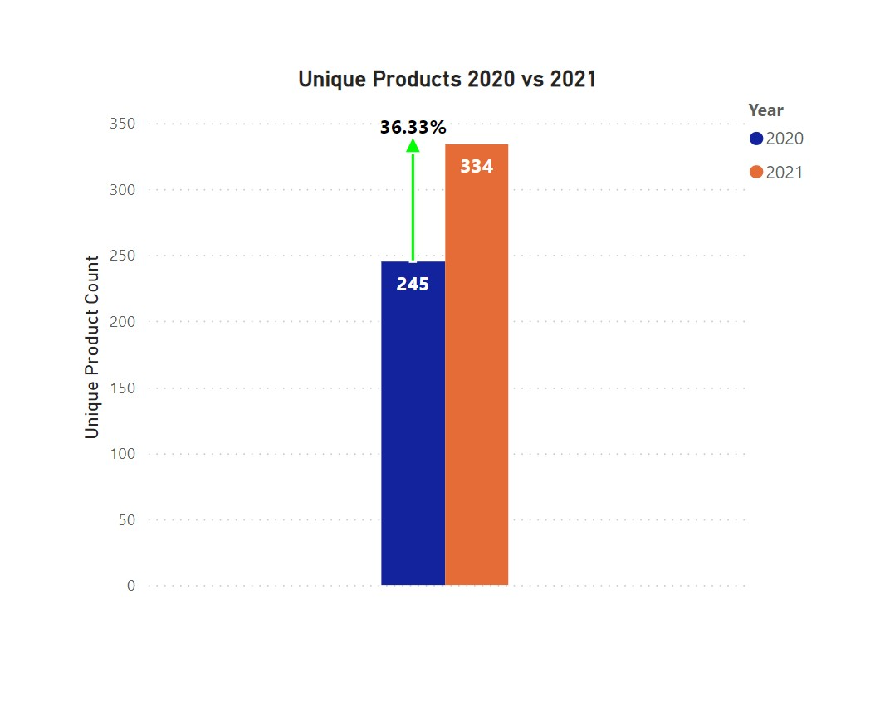

tliQo Hardware
Ad-hoc Analysis
Request 2
Visual
What is the percentage of unique product increase
in 2021 vs. 2020?
Output:
BY BALOGUN ALI
#codebasicsresumeprojectchallenge

Slide 8
tliQo Hardware
Insight
Atliq produced 89 unique products in FY 2021, representing a 36% increase from FY 2020, which indicates the company's ability to adapt to changes in the market and respond to emerging trends, which can be an important factor for long-term success.
BY BALOGUN ALI
#codebasicsresumeprojectchallenge

Slide 9
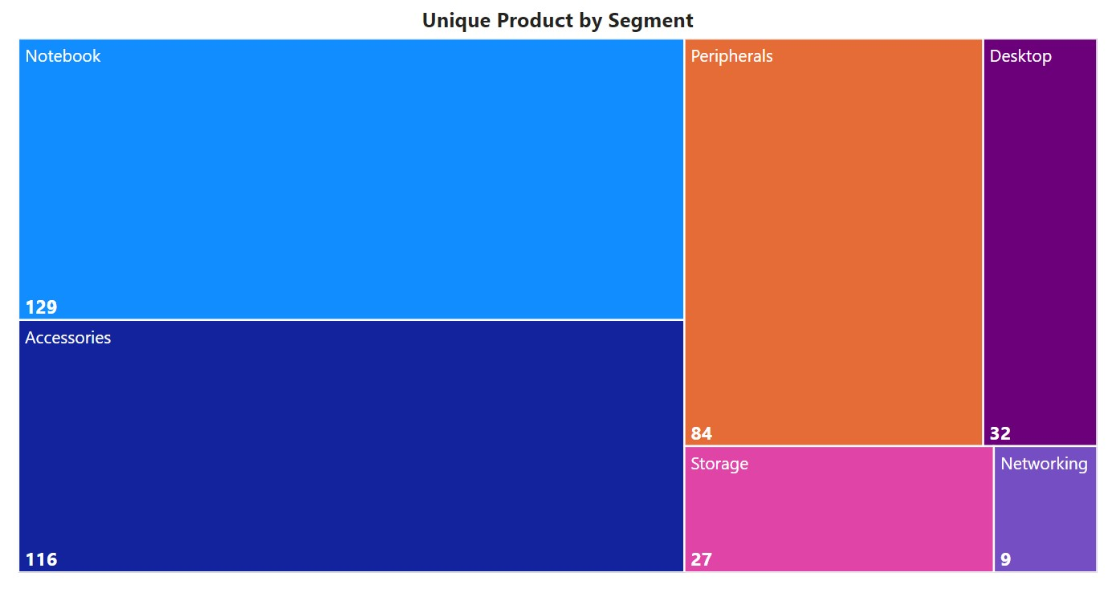
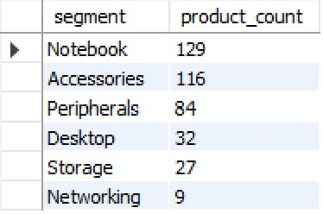
tliQo Hardware
Ad-hoc Analysis
Request 3
Visual
Provide a report with all the unique product counts
for each segment and sort them in descending order of product counts.
Output:
BY BALOGUN ALI
#codebasicsresumeprojectchallenge

Slide 10
tliQo Hardware
Insight
Among Atliq's six product segments, Notebook segment had the most unique products, while Networking, Desktop, and Storage had the least.
The reason behind the high number of unique products in the Notebook & Accesories segment could be:
Technological advancemets.
Competitive nature of the market.
The reason behind the lownumber of unique products in the Network & Storage segment could be:
Interoperability with different devices, so no need for multiple unique versions.
BY BALOGUN ALI
#codebasicsresumeprojectchallenge

Slide 11
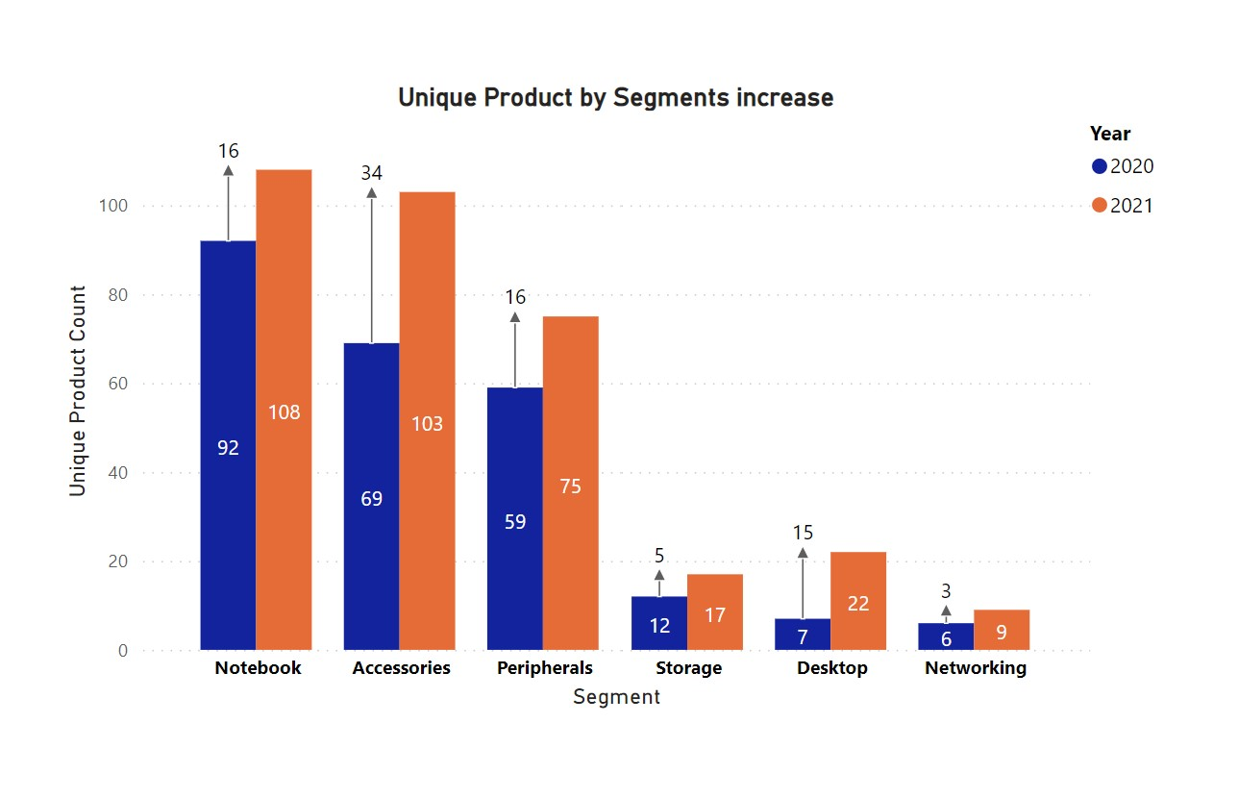
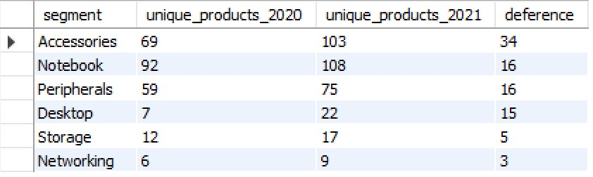
tliQo Hardware
Ad-hoc Analysis
Request 4
Visual
Follow-up: Which segment had the most increase in
unique products in 2021 vs 2020?
Output:
BY BALOGUN ALI
#codebasicsresumeprojectchallenge

Slide 12
tliQo Hardware
Insight
Among Atliq's six product segments, the segment with the highest rise in unique products between 2020 and 2021 is Accessories. With a difference of 34 between 2020 and 2021
BY BALOGUN ALI
#codebasicsresumeprojectchallenge

Slide 13
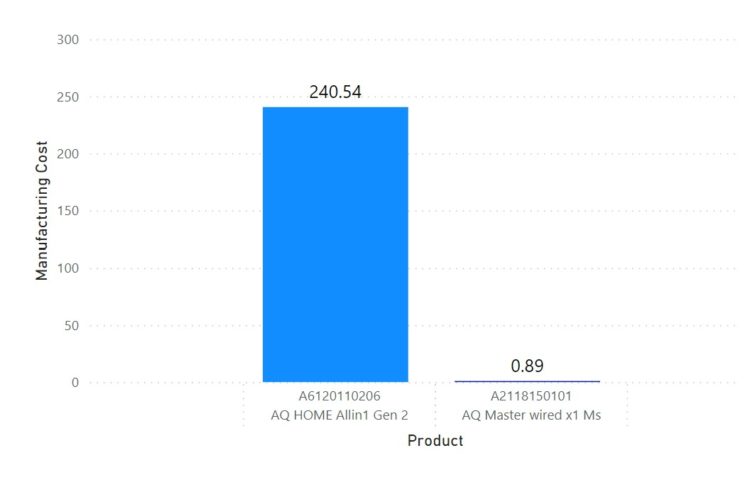
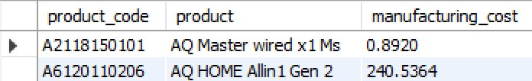
tliQo Hardware
Ad-hoc Analysis
Request 5
Visual
Get the products that have the highest and lowest
manufacturing costs.
Output:
BY BALOGUN ALI
#codebasicsresumeprojectchallenge

Slide 14
tliQo Hardware
Insight
The product AQ Master wired x1 Ms has the lowest manufacturing cost, of 0.892. And the product AQ HOME Allin 1 Gen 2 has the highest manufacturing cost, which is 240.5364
BY BALOGUN ALI
#codebasicsresumeprojectchallenge

Slide 15
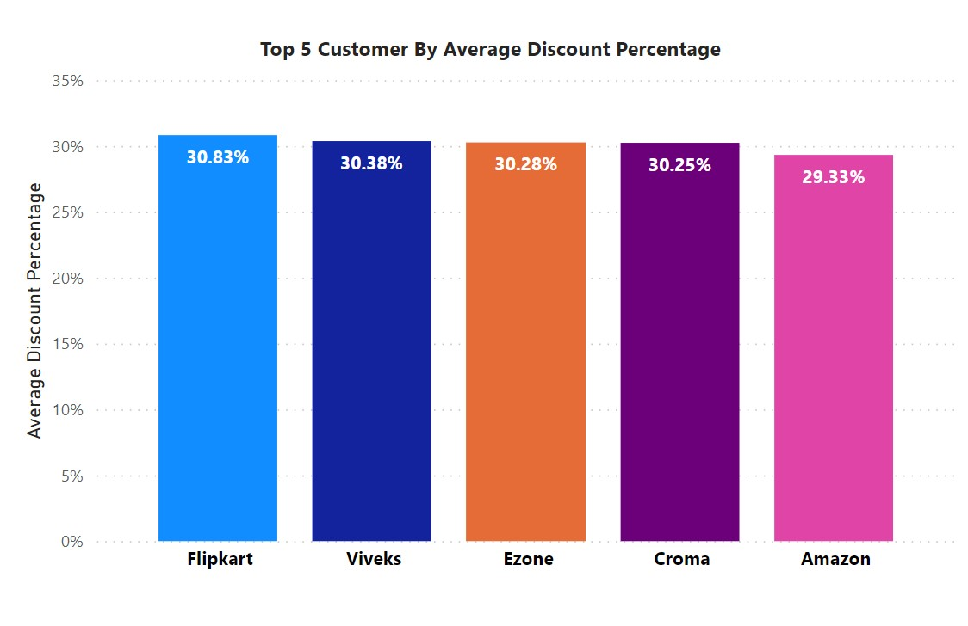
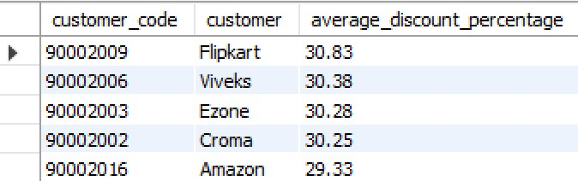
tliQo Hardware
Ad-hoc Analysis
Request 6
Visual
Generate a report which contains the top 5 customers who received an average high pre_invoice_discount_pct for the fiscal year 2021 and in the Indian market.
Output:
BY BALOGUN ALI
#codebasicsresumeprojectchallenge

Slide 16
tliQo Hardware
Insight
For the fiscal year 2021, the top 5 customers having the average high pre-invoice discount percentage in the Indian market are Flipkart the highest with an average pre-invoice discount percentage of 30.83%, followed by Viveks, Ezone, Croma and Amazon.
BY BALOGUN ALI
#codebasicsresumeprojectchallenge

Slide 17
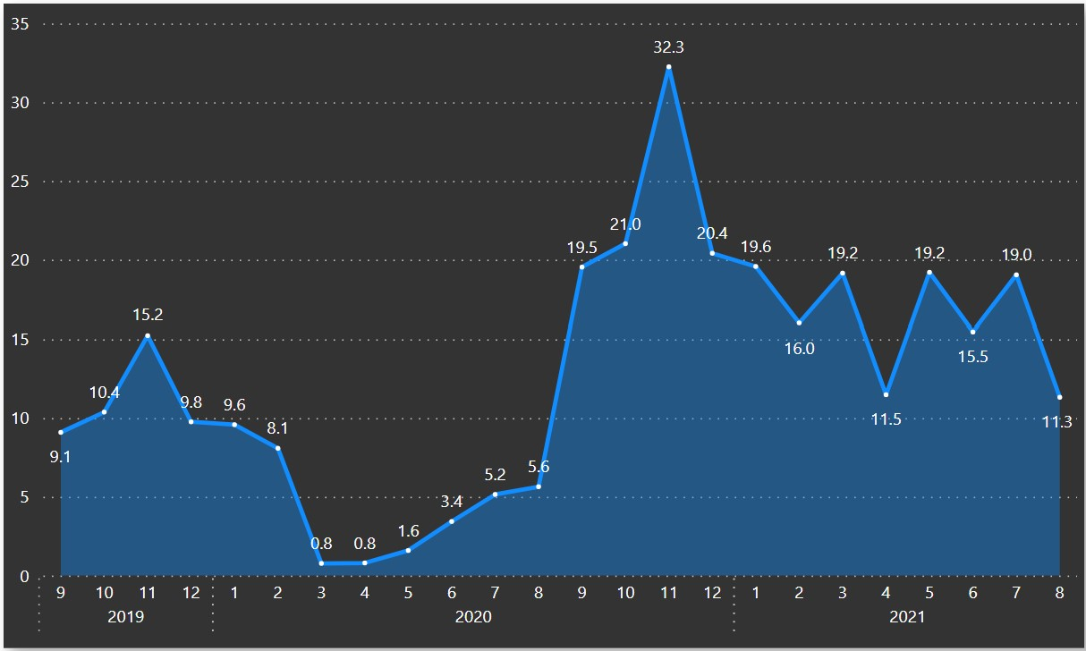
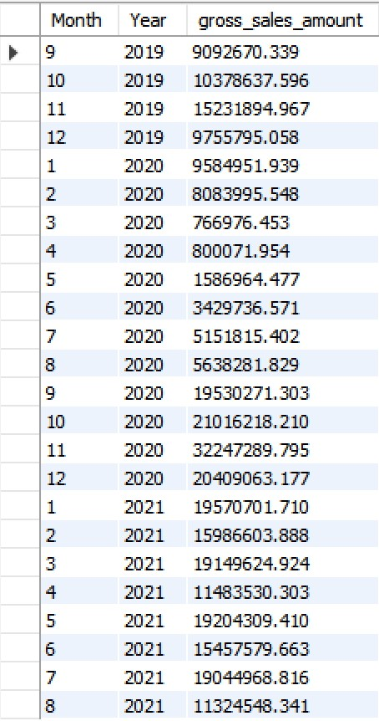
tliQo Hardware
Ad-hoc Analysis
Request 7
Visual
Get the complete report of the Gross sales amount for the customer “Atliq Exclusive” for each month. This analysis helps to understand low and high-performing months and take
strategic decisions. Output:
BY BALOGUN ALI
#codebasicsresumeprojectchallenge

Slide 18
tliQo Hardware
Insight
In November 2020, Atliq Exclusive recorded its highest gross sales amount of 32.25M, while its lowest gross sales of 767K was recorded in March 2020. The company experienced a decrease in sales between March to August, which was attributed to the manufacturing halts caused by the COVID-19 lockdown. However, sales began to increase after August due to the adoption of virtual engagement in both schools and work increassing the demnad in the market. This culminated in the company achieving its highest gross sales amount in November.
BY BALOGUN ALI
#codebasicsresumeprojectchallenge

Slide 19
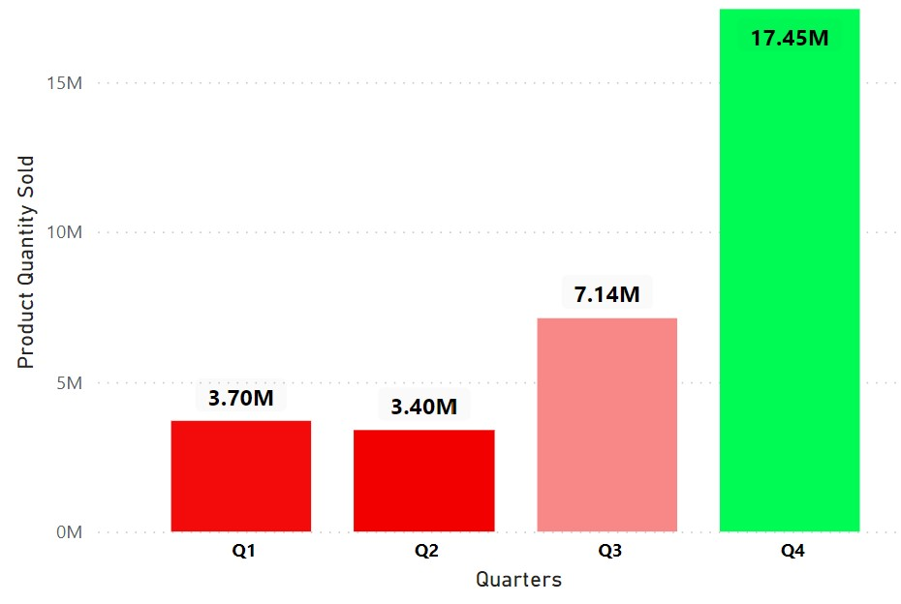
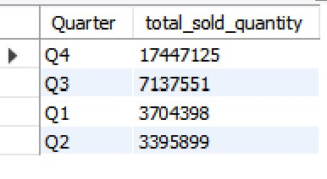
tliQo Hardware
Ad-hoc Analysis
Request 8
Visual
In which quarter of 2020, got the maximum
total_sold_quantity?
Output:
BY BALOGUN ALI
#codebasicsresumeprojectchallenge

Slide 20
tliQo Hardware
Insight
The fourth quarter is typically a strong period for sales in the technology industry, which may explain the higher sales during this period. This could be due to factors such as holiday sales or end-of-year budget spending.
The third quarter may also be a significant period for sales, indicating that the company's products are in demand during the summer months.
The first quarter may be a slightly slower period for sales, possibly due to the post-holiday season or the start of a new fiscal year for some companies.
The company may need to adjust its production and inventory management strategy to align with the seasonal trends in sales.
BY BALOGUN ALI
#codebasicsresumeprojectchallenge

Slide 21
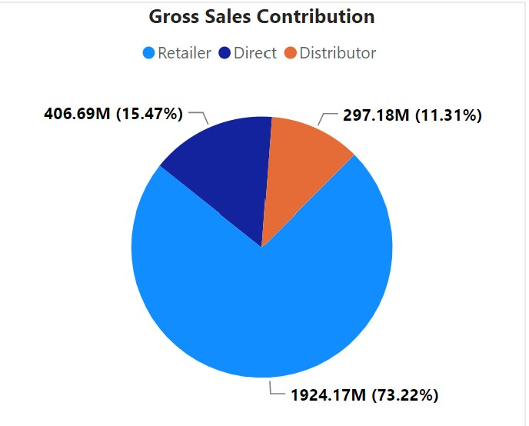
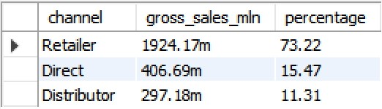
tliQo Hardware
Ad-hoc Analysis
Request 9
Visual
Which channel helped to bring more gross sales in the fiscal year 2021 and the percentage of contribution?
Output:
BY BALOGUN ALI
#codebasicsresumeprojectchallenge

Slide 22
tliQo Hardware
Insight
Retailers are the most important distribution channel for the company, accounting for 73.22% of its sales. This indicates that the company has a strong relationship with retailers and may need to focus on maintaining these relationships to ensure continued success.
Direct and distributor channels account for a smaller share of the company's sales, suggesting that the company may want to consider increasing its efforts in these areas to diversify its sales channels and reach new customers.
BY BALOGUN ALI
#codebasicsresumeprojectchallenge

Slide 23
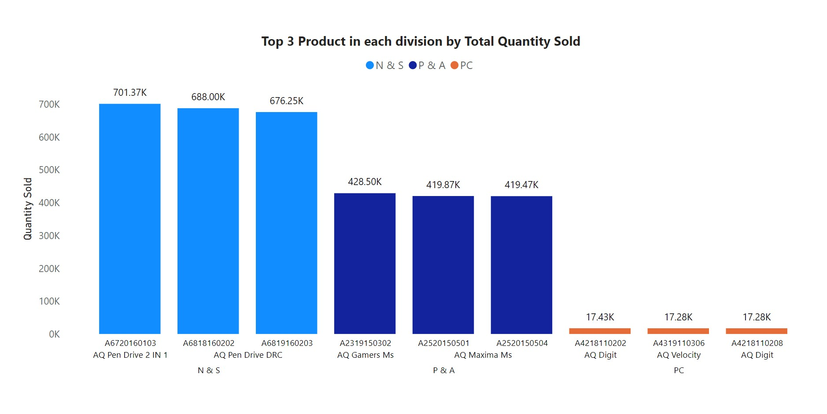
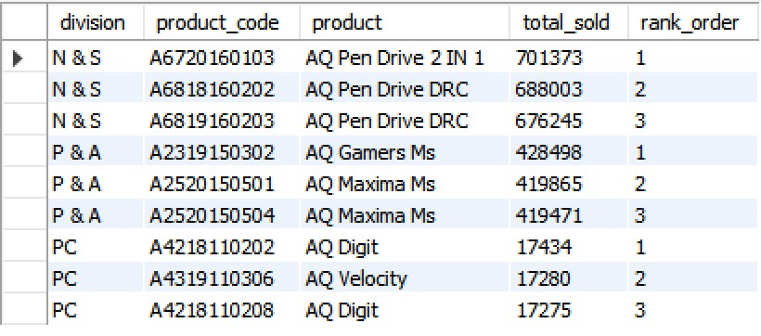
tliQo Hardware
Ad-hoc Analysis
Request 10
Visual
Get the Top 3 products in each division that have a high total_sold_quantity in the
fiscal_year 2021.
Output:
BY BALOGUN ALI
#codebasicsresumeprojectchallenge

Slide 24
tliQo Hardware
Insight
The most sold quantity for the top 3 products is from N & S division.
BY BALOGUN ALI
#codebasicsresumeprojectchallenge

Slide 25
tliQo Hardware
THANK
YOU
BY BALOGUN ALI
#codebasicsresumeprojectchallenge

